Slide 1
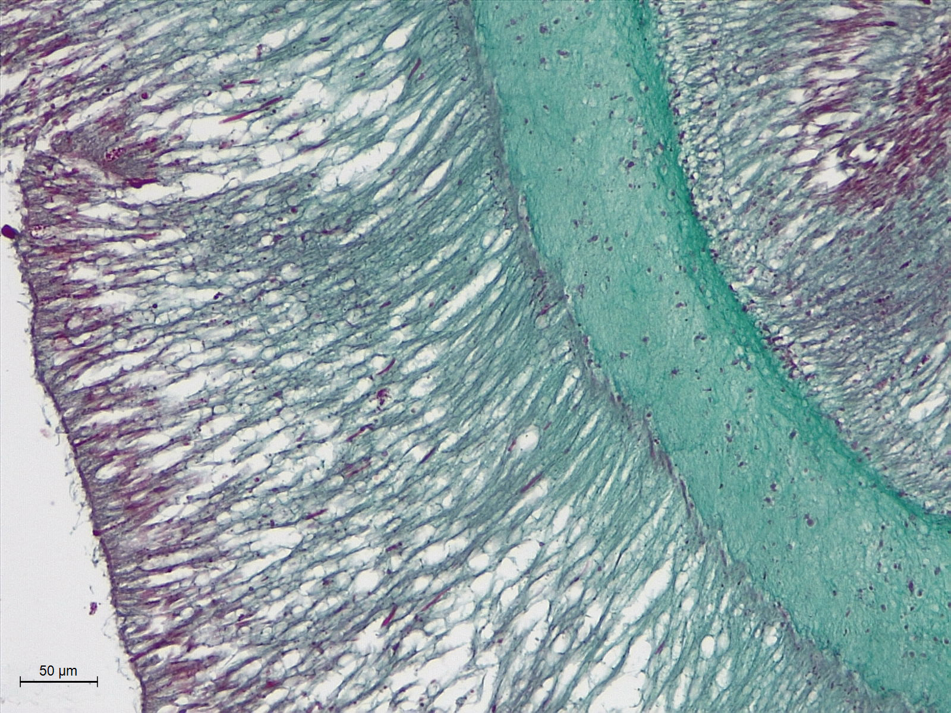
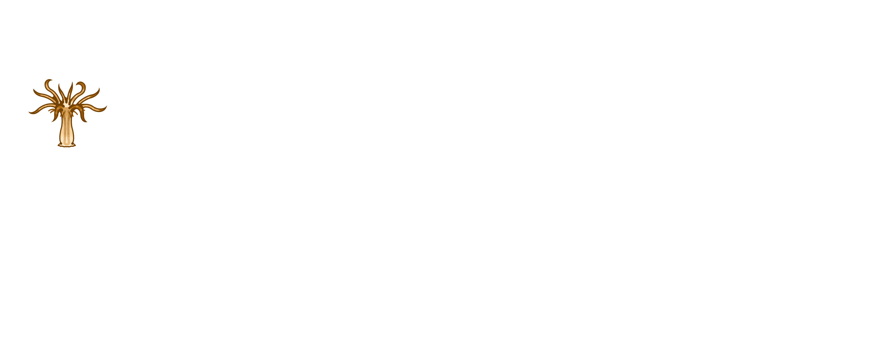


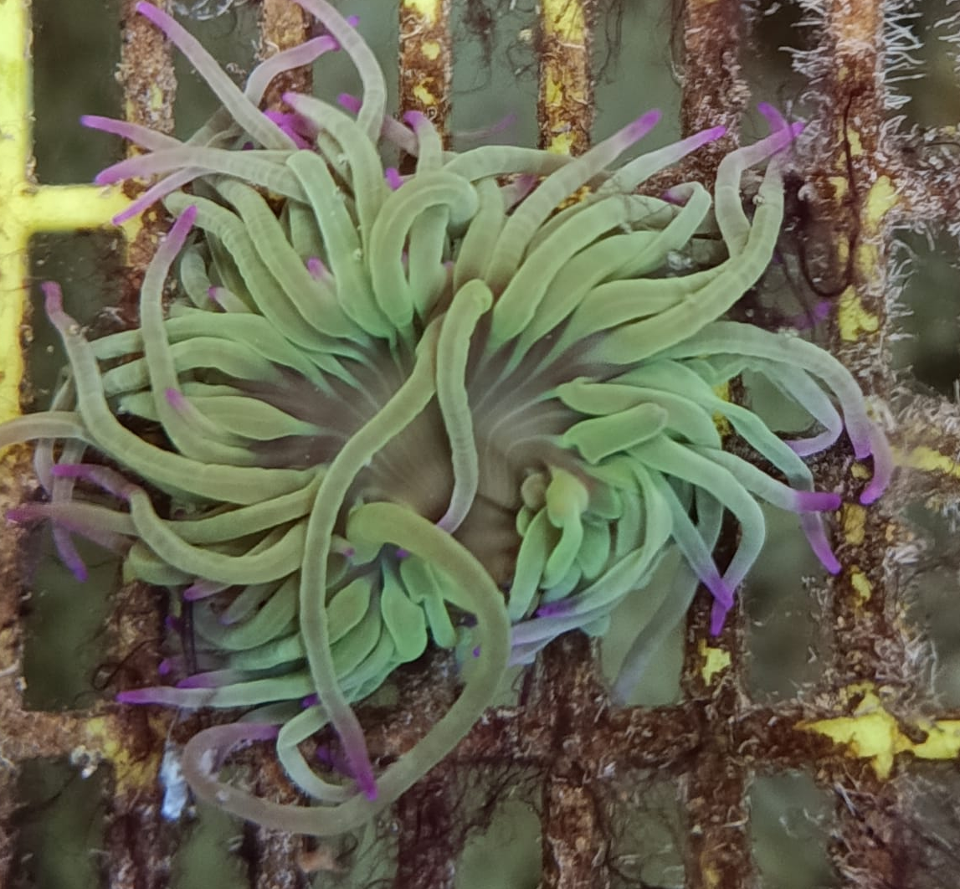
Longitudinal section is a viable inductor of asexual reproduction in Anemonia viridis
Higher CAT, GPx, GR activity in column and tentacle
Antioxidants are effective against lipid peroxidation
Collagen infiltration into tissues
Amoebocyte recruitment
6 hours
24 hours
7 days
4 weeks
20 weeks
Wound has healed
Amoebocyte recruitment
Tentacular antioxidants revert to normal
Protection against lipid peroxidation
Exposed mesoglea is sealed

